Slide 1
The War on Drugs

Slide 2
As the crime rate increased from the 1960s to the 1990s, U.S. politicians were under pressure to appear “Tough on Crime.”

Slide 3
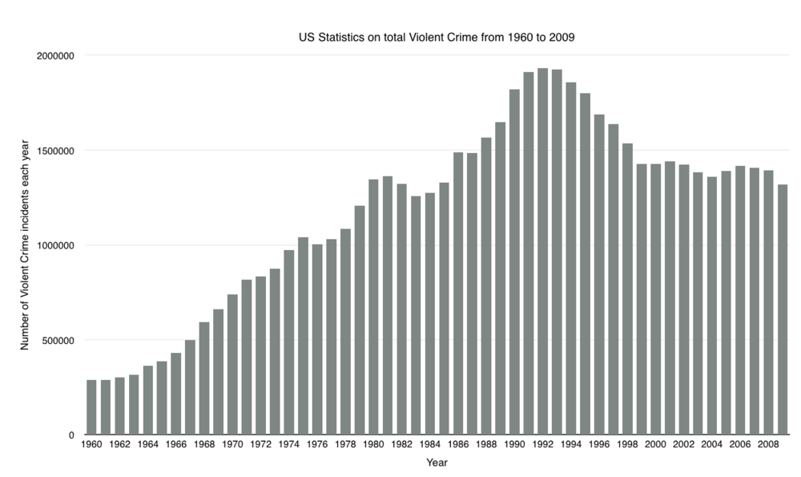

Slide 4
“Tough on Crime”
As crime rates increased, Politicians sought advantage by advocating to be “Tough on Crime.”
1988 US Presidential Election: the infamous “Willie Horton Ad”
    https://www.youtube.com/watch?time_continue=30&v=Io9KMSSEZ0Y
    Remember Recidivism?

Slide 5
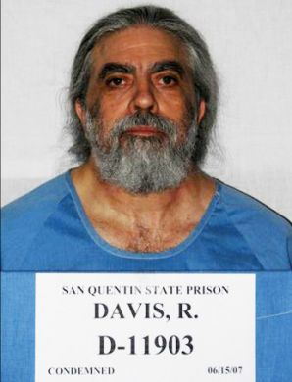
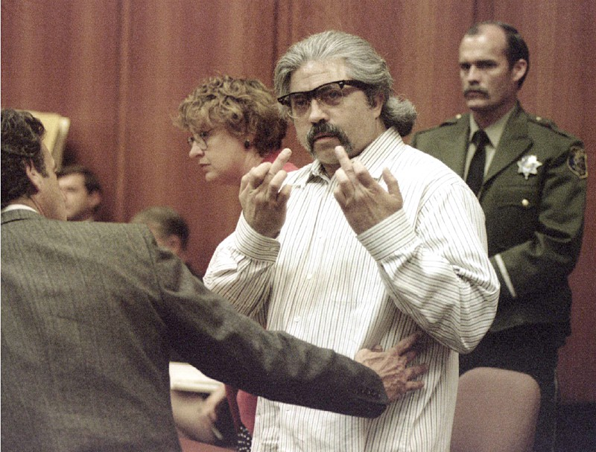
In 1993, Richard Allen Davis was arrested for the kidnapping, rape, and murder of 12-year old Polly Klaas.
In 1996, Davis was sentenced to the Death Penalty.
Davis had a long history of repeated criminal convictions.
    For example, when Davis committed the above crimes, he was currently on parole for a previous conviction of kidnapping, assault, and robbery.

Slide 6
Three Strikes Law
One of the first significant legislative innovations to get “tough on crime” was the Three-Strikes Law
Initially passed in California in 1994 in response to the Davis Case.
Currently 28 States and U.S. Federal Government have some form of three strikes law.

Slide 7
Terms of Sentencing
Felony. There are three kinds of crimes: infractions, misdemeanors, and
felonies. Felonies are the most serious type of crime, and offenders who
commit felonies may be sentenced to state prison.
Violent Offense. State law (Penal Code [P.C.] 667.5) defines some felonies as “violent.” Examples of such felonies include murder, robbery, and rape and other sex offenses.
Serious Offense. State law (P.C. 1192.7) defines some felonies as “serious.” Serious felonies include the same offenses as violent felonies, but also include other offenses such as burglary of a residence and assault with intent to commit robbery.
Sentence Enhancement. This is additional time added to a criminal
defendant’s sentence for specified reasons relating to the nature of the crime or the offender’s criminal history.

Slide 8
TSL – How it works - 1
A person who is convicted of a serious or violent felony gets a “Strike.”
At this time, the convicted person receives the “standard” punishment

Slide 9
TSL – How it works - 2
A person with one “Strike” prior, who is convicted of any felony gets a second “Strike.” For the second strike, the person must serve twice the normal prison term.

Slide 10
TSL – How it Works - 3
A person with two “Strike” priors, who is convicted of any felony gets a third “Strike.” The minimum sentence is 25 years to life.

Slide 11
TSL – Example: Ewing v. California
The Ewing case involved a repeat offender sentenced to prison for 25 years to life under the Three Strikes law for stealing golf clubs (value $400) from a Los Angeles country club (a non-serious, nonviolent offense).
Ewing argued that the sentence violated the U.S. Constitution’s prohibition against “cruel and unusual punishment.”
  The Court previously stated that the imposition of a sentence that is grossly disproportionate to the severity of the crime violates this prohibition.
In 2003, the U.S. Supreme Court, in a 5-4 decision, upheld the constitutionality of California’s Three Strikes law. The court argued, “Ewing’s sentence is justified by the State’s public safety interest in incapacitating and deterring recidivist felons….” and that “selecting sentencing rationales is generally a policy choice to be made by state legislatures, not federal courts.”

Slide 12
TSL – Other examples
Stealing a pair of white socks (value $2.50)
Stealing a slice of pizza
Stealing a car radio
Possession of 0.14 grams of meth (A narcotic).

Slide 13
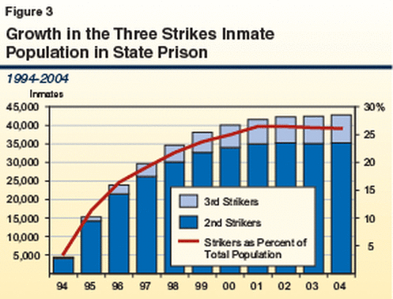

Slide 14
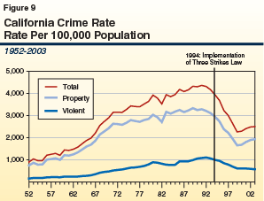

Slide 15
2012 Reforms
In 2012, proposition 12 was passed by California voters to amend the three strikes law:
The change to the TSL were small but important:
  For the third strike, the offense had to be “serious” or “violent” to get usual punishment.
  Otherwise, the third strike is treated as a second strike.

Slide 16
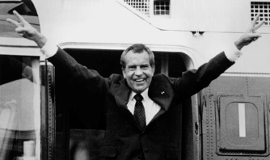
In 1971 President Richard Nixon declared America’s “war on drugs.” He proclaimed, “America’s public enemy number one in the United States is drug abuse. In order to fight and defeat this enemy, it is necessary to wage a new, all-out offensive”
Nixon’s policy would be to go after both supply and demand:
The suppliers who provided the drugs
The users of drugs (i.e. recreational users)

Slide 17
References
https://www.youtube.com/watch?v=y8TGLLQlD9M (Nixon: “28-’1”20)
https://www.youtube.com/watch?v=JmpNchXGQlU (Affluenza)
https://www.mass.gov/files/documents/2018/07/10/Final%20Advisory%20Sentencing%20Guidelines%2020180621.pdf(Sentencing example – P.47)

